Slide 1

Chapter 12:
Advanced
File Operations

Slide 2
12.1
File Operations

Slide 3

File Operations
File: a set of data stored on a computer, often on a disk drive
Programs can read from, write to files
Used in many applications:
  Word processing
  Databases
  Spreadsheets
  Compilers

Slide 4
Using Files
Requires fstream header file
  use ifstream data type for input files
  use ofstream data type for output files
  use fstream data type for both input, output files
Can use >>, << to read from, write to a file
Can use eof member function to test for end of input file

Slide 5
fstream Object
fstream object can be used for either input or output
Must specify mode on the open statement
Sample modes:
  ios::in – input
  ios::out – output
Can be combined on open call:
  dFile.open("class.txt", ios::in | ios::out);

Slide 6
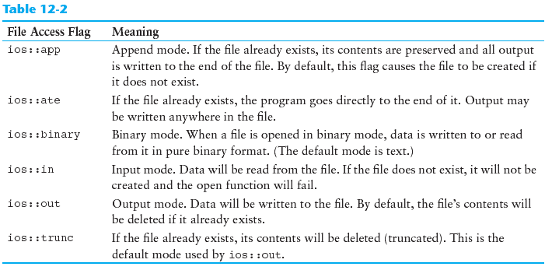
File Access Flags

Slide 7
Using Files - Example
  // copy 10 numbers between files
  // open the files
  fstream infile("input.txt", ios::in);
  fstream outfile("output.txt", ios::out);
  int num;
  for (int i = 1; i <= 10; i++)
  {
  infile >> num; // use the files
  outfile << num;
  }
  infile.close(); // close the files
  outfile.close();

Slide 8
Default File Open Modes
ifstream:
  open for input only
  file cannot be written to
  open fails if file does not exist
ofstream:
  open for output only
  file cannot be read from
  file created if no file exists
  file contents erased if file exists

Slide 9
More File Open Details
Can use filename, flags in definition:
  ifstream gradeList("grades.txt");
File stream object set to 0 (false) if open failed:
  if (!gradeList) ...
Can also check fail member function to detect file open error:
  if (gradeList.fail()) ...

Slide 10
12.2
File Output Formatting

Slide 11
File Output Formatting
Use the same techniques with file stream objects as with cout: showpoint, setw(x), showprecision(x), etc.
Requires iomanip to use manipulators

Slide 12
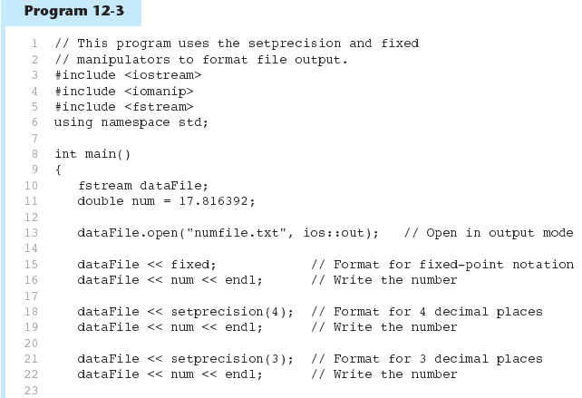

Slide 13
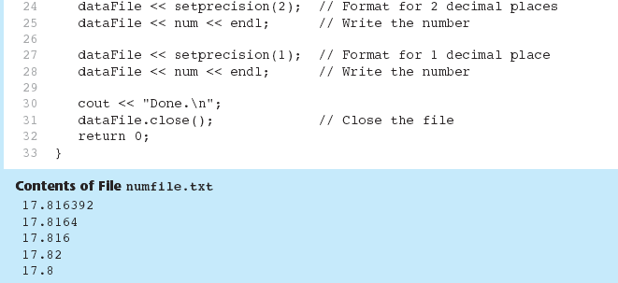
Program 12-3 (Continued)

Slide 14
12.3
Passing File Stream Objects to Functions

Slide 15
Passing File Stream Objects to Functions
It is very useful to pass file stream objects to functions
Be sure to always pass file stream objects by reference

Slide 16
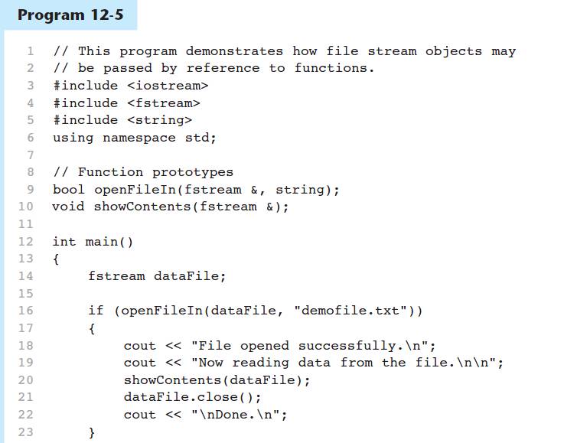

Slide 17
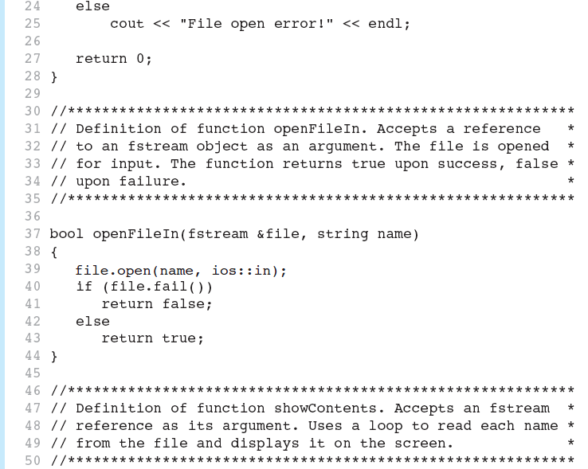

Slide 18
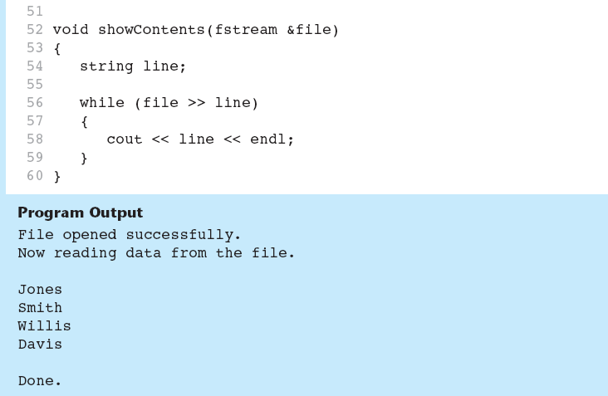

Slide 19
12.4
More Detailed Error Testing

Slide 20
More Detailed Error Testing
Can examine error state bits to determine stream status
Bits tested/cleared by stream member functions
ios::eofbit | set when end of file detected
ios::failbit | set when operation failed
ios::hardfail | set when error occurred and no recovery
ios::badbit | set when invalid operation attempted
ios::goodbit | set when no other bits are set

Slide 21
Member Functions / Flags
eof() | true if eofbit set, false otherwise
fail() | true if failbit or hardfail set, false otherwise
bad() | true if badbit set, false otherwise
good() | true if goodbit set, false otherwise
clear() | clear all flags (no arguments), or clear a specific flag

Slide 22
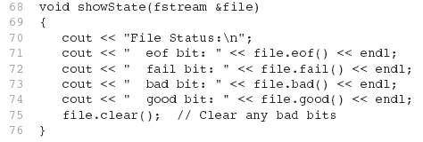
From Program 12-6

Slide 23
12.5
Member Functions for Reading and Writing Files

Slide 24
Member Functions for Reading and Writing Files
Functions that may be used for input with whitespace, to perform single character I/O, or to return to the beginning of an input file
Member functions:
  getline: reads input including whitespace
  get: reads a single character
  put: writes a single character

Slide 25
The getline Function
Three arguments:
  Name of a file stream object
  Name of a string object
  Delimiter character of your choice
  Examples, using the file stream object myFile, and the string objects name and address:
  getline(myFile, name);
  getline(myFile, address, '\t');
  If left out, '\n' is default for third argument

Slide 26
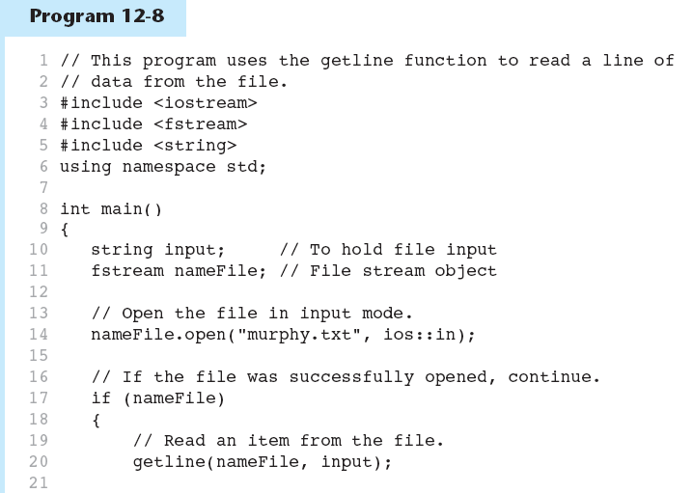

Slide 27
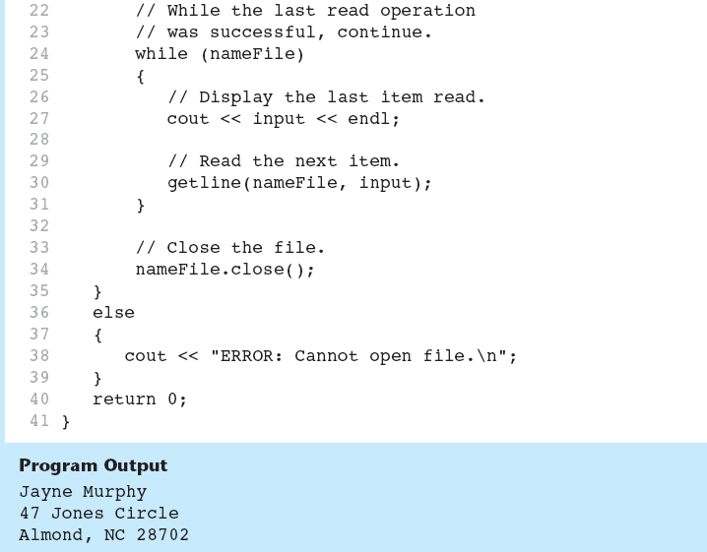

Slide 28
Single Character I/O
get: read a single character from a file
  char letterGrade;
  gradeFile.get(letterGrade);
  Will read any character, including whitespace
put: write a single character to a file
  reportFile.put(letterGrade);

Slide 29
12.6
Working with Multiple Files

Slide 30
Working with Multiple Files
Can have more than file open at a time in a program
Files may be open for input or output
Need to define file stream object for each file

Slide 31
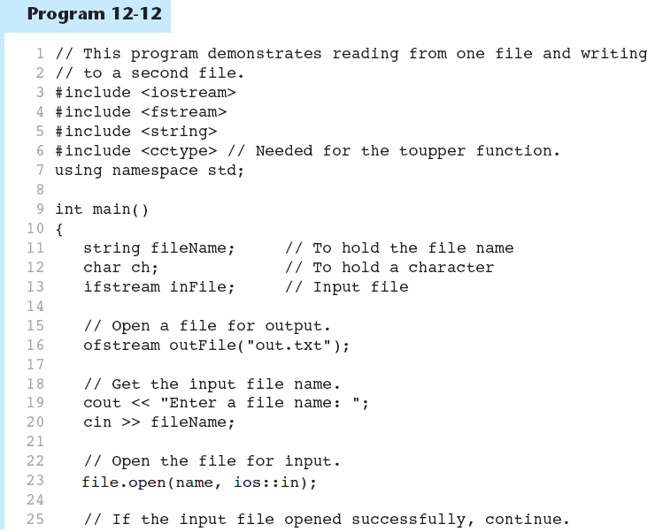

Slide 32
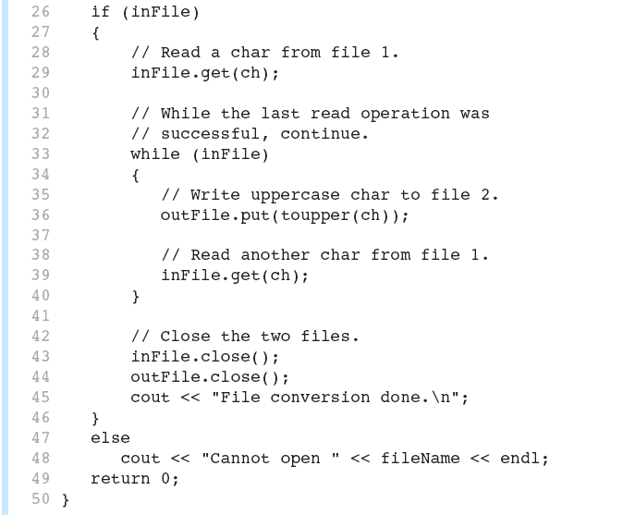

Slide 33


Slide 34
12.7
Binary Files

Slide 35
Binary Files
Binary file contains unformatted, non-ASCII data
Indicate by using binary flag on open:
  inFile.open("nums.dat", ios::in | ios::binary);

Slide 36
Binary Files
Use read and write instead of <<, >>
  char ch;
  // read in a letter from file
  inFile.read(&ch, sizeof(ch));
  // send a character to a file
  outFile.write(&ch, sizeof(ch));
address of where to put
the data being read in.
The read function expects
to read chars
how many bytes to
read from the file
12-<number>

Slide 37
Binary Files
To read, write non-character data, must use a typecast operator to treat the address of the data as a character address
  int num;
  // read in a binary number from a file
  inFile.read(reinterpret_cast<char *>&num,
  sizeof(num));
  // send a binary value to a file
  outf.write(reinterpret_cast<char *>&num,
  sizeof(num));
treat the address of num as
the address of a char

Slide 38
12.8
Creating Records with Structures

Slide 39
Creating Records with Structures
Can write structures to, read structures from files
To work with structures and files,
  use ios::binary file flag upon open
  use read, write member functions

Slide 40
Creating Records with Structures
  struct TestScore
  {
  int studentId;
  double score;
  char grade;
  };
  TestScore oneTest;
  ...
  // write out oneTest to a file
  gradeFile.write(reinterpret_cast<char *> (&oneTest), sizeof(oneTest));

Slide 41
12.9
Random-Access Files

Slide 42
Random-Access Files
Sequential access: start at beginning of file and go through data in file, in order, to end
  to access 100th entry in file, go through 99 preceding entries first
Random access: access data in a file in any order
  can access 100th entry directly

Slide 43
Random Access Member Functions
seekg (seek get): used with files open for input
seekp (seek put): used with files open for output
Used to go to a specific position in a file

Slide 44
Random Access Member Functions
seekg,seekp arguments:
  offset: number of bytes, as a long
  mode flag: starting point to compute offset
Examples:
  inData.seekg(25L, ios::beg);
  // set read position at 26th byte
  // from beginning of file
  outData.seekp(-10L, ios::cur);
  // set write position 10 bytes
  // before current position

Slide 45
Important Note on Random Access
If eof is true, it must be cleared before seekg or seekp:
  gradeFile.clear();
  gradeFile.seekg(0L, ios::beg);
  // go to the beginning of the file

Slide 46
Random Access Information
tellg member function: return current byte position in input file
  long int whereAmI;
  whereAmI = inData.tellg();
tellp member function: return current byte position in output file
  whereAmI = outData.tellp();

Slide 47
12.10
Opening a File for
Both Input and Output

Slide 48
Opening a File for
Both Input and Output
File can be open for input and output simultaneously
Supports updating a file:
  read data from file into memory
  update data
  write data back to file
Use fstream for file object definition:
  fstream gradeList("grades.dat",
  ios::in | ios::out);
Can also use ios::binary flag for binary data

